Slide 1

TEXT CATEGORIZATION
(CLASSIFICATION)
-- Text representation --

Slide 2
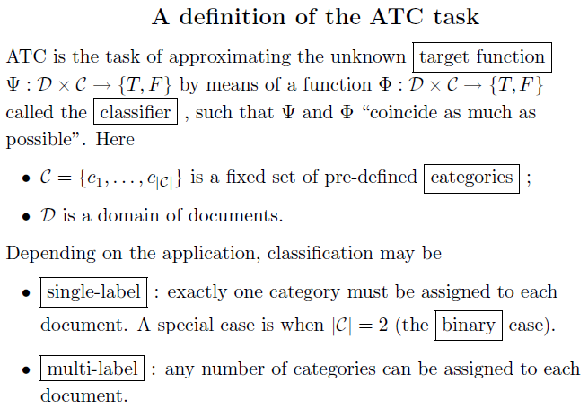
TEXT CLASSIFICATION (CATEGORISATION)
– the assignment of natural language texts to one or more predefined categories (classes)
based on their content.
Automated text categorization (ATC)

Slide 3
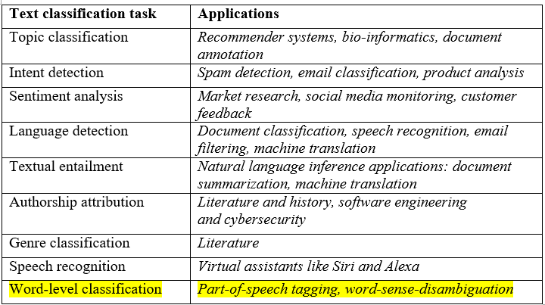
APPLICATIONS OF ATC

Slide 4
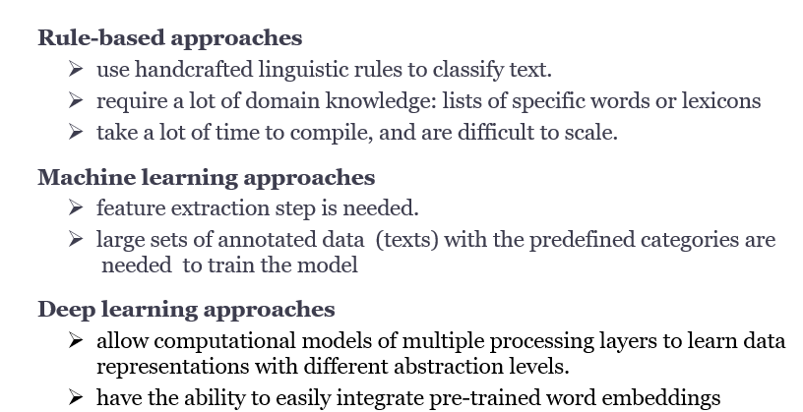
APPROACHES

Slide 5
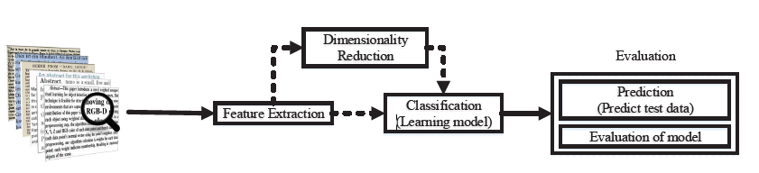
Machine learning approach

Slide 6
TEXT PRE-PROCESSING
Tokenization
Stop words removal
    words that are widely used but they carry very little useful information.
    Ex: {a, the, is, are, then, you, it, what,….}
Capitalization: reduce every letter to lower case
Slang and abbreviation: convert them into formal language
Noise removal: eliminate unnecessary characters (punctuation, special characters)
Stemming
Lemmatization

Slide 7
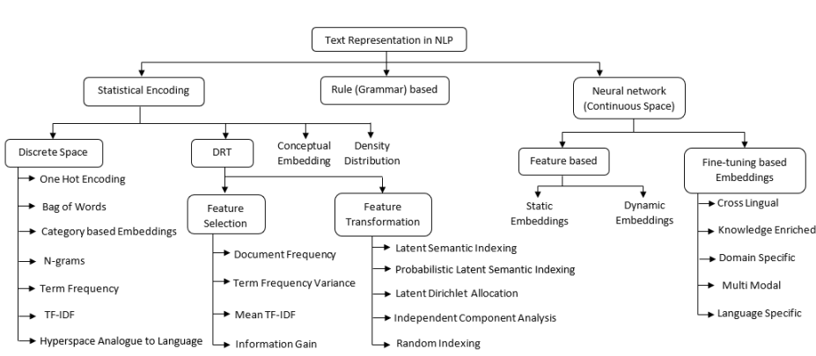
EMBEDDING TAXONOMY

Slide 8
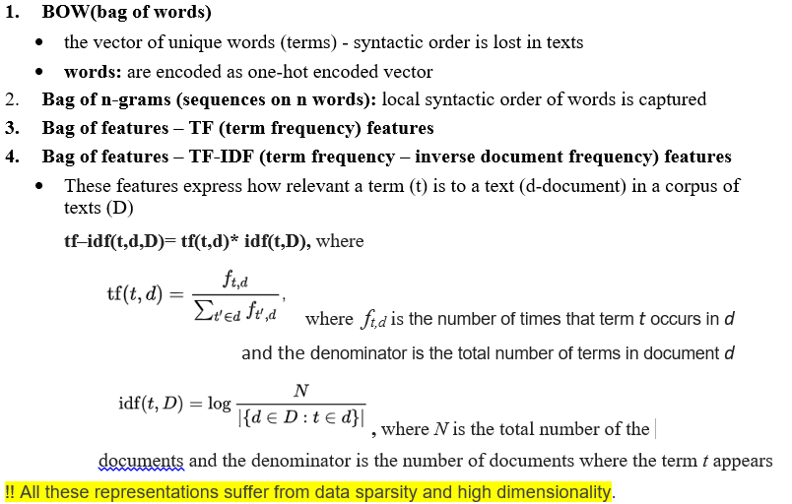
TEXT REPRESENTATION - SYNTACTIC FEATURES

Slide 9
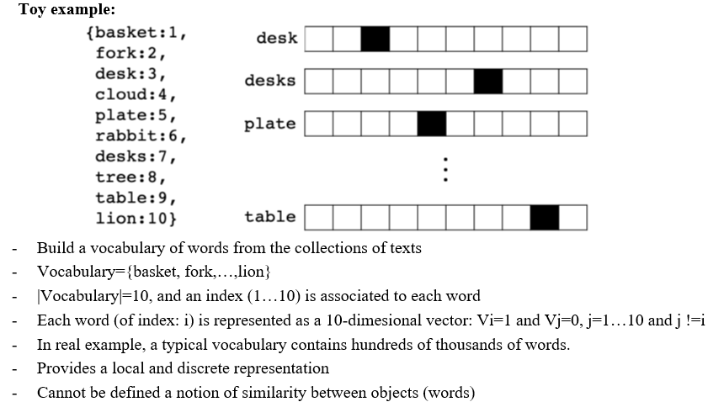
ONE-HOT REPRESENTATION –
THE SIMPLEST FORM OF WORD REPRESENTATION

Slide 10
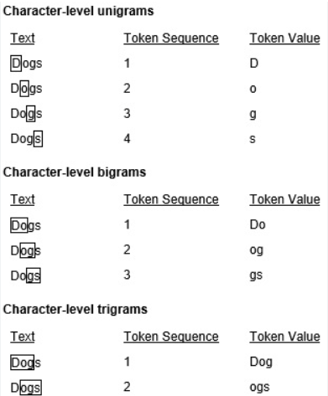
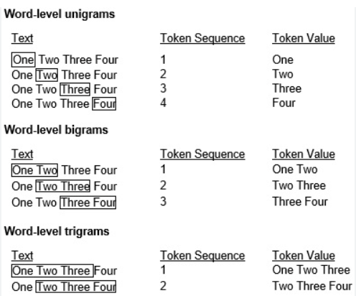
N-GRAM: A TOKEN SEQUENCE OF N ENTITIES IN A TEXT

Slide 11
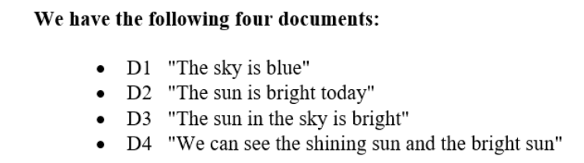
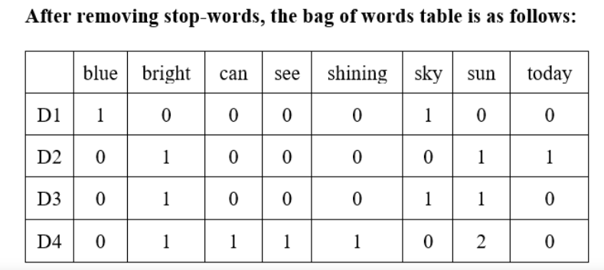
TEXT REPRESENTATIONS:
BAG-OF-WORDS AND BAG-OF-FEATURES (TERM FREQUENCY)

Slide 12


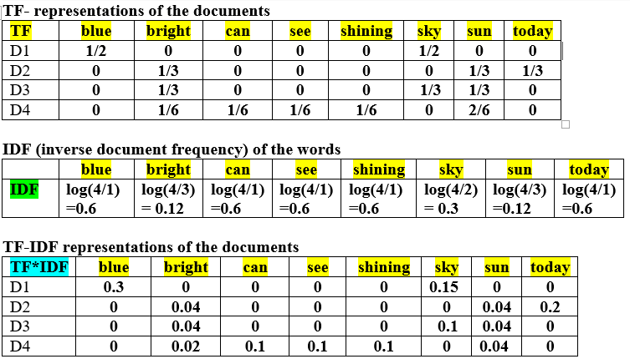
TF-IDF REPRESENTATIONS FOR THE SET OF DOCUMENTS, N=4

Slide 13
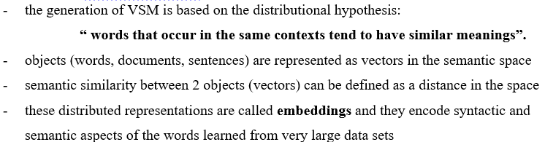
SEMANTIC REPRESENTATIONS - VECTOR SPACE MODELS (VSM)

Slide 14
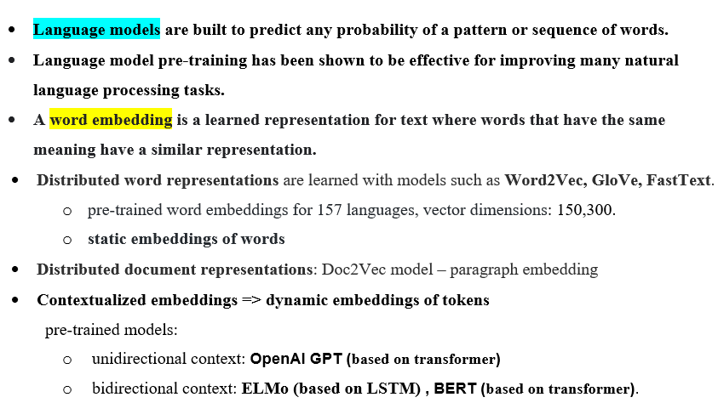
LANGUAGE MODELS

Slide 15
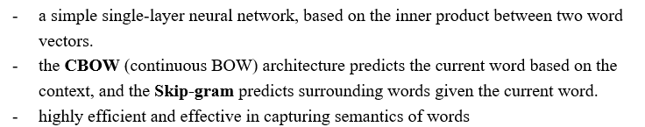
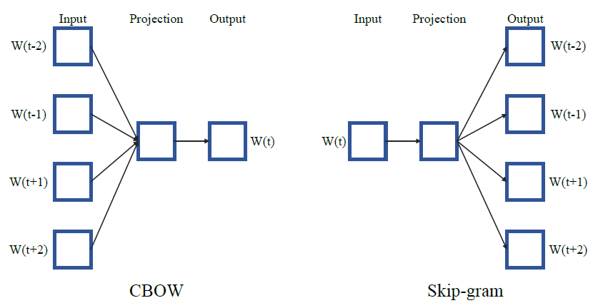
WORD2VEC MODEL

Slide 16
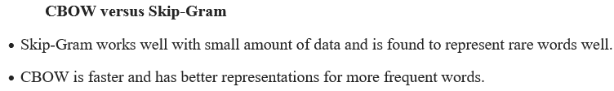
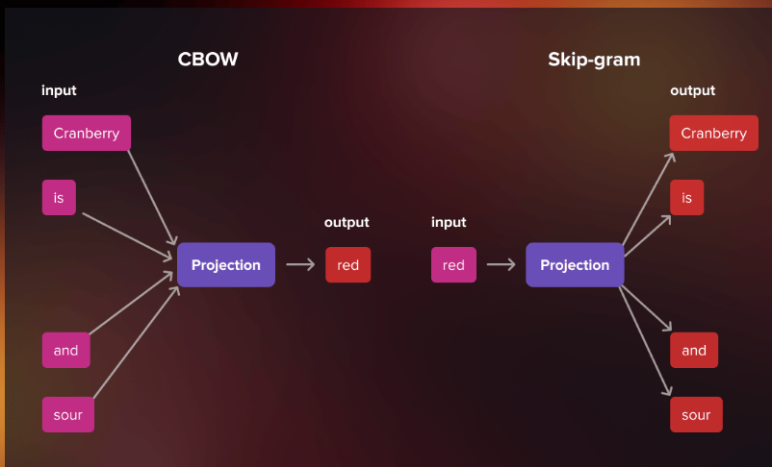
WORD2VEC

Slide 17
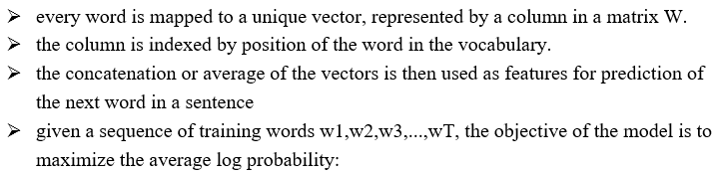
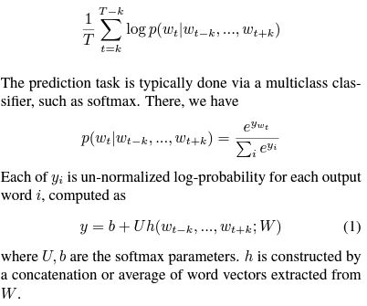
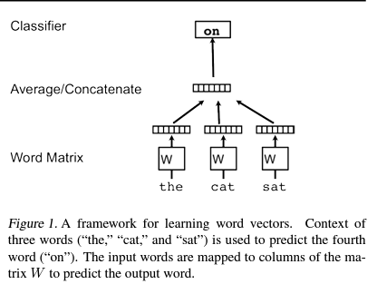
WORD2VEC

Slide 18
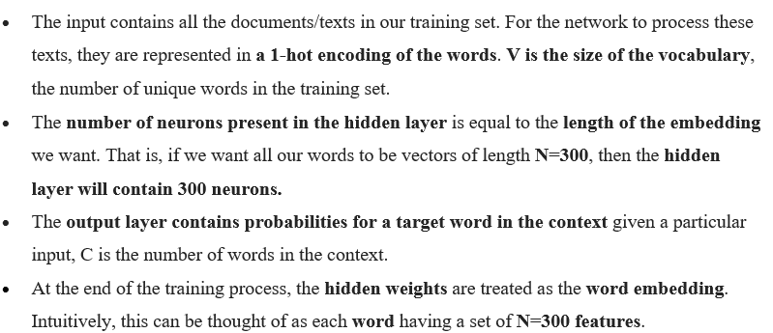
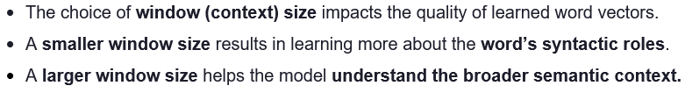
WORD2VEC - A SHALLOW NEURAL NETWORK

Slide 19
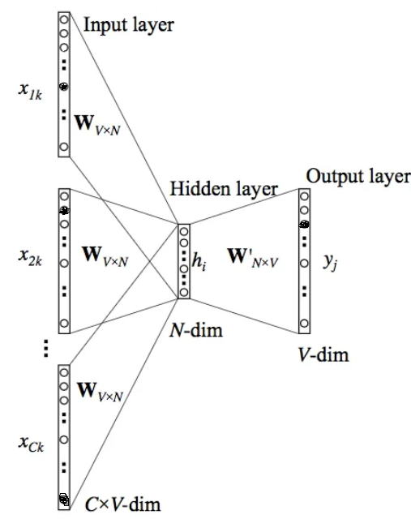
CBOW MODEL

Slide 20
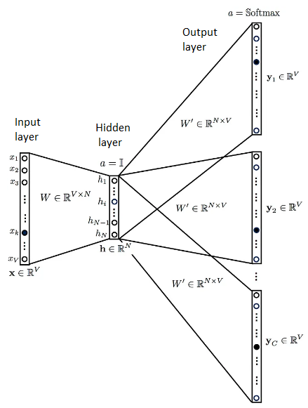
SKIP-GRAM MODEL

Slide 21
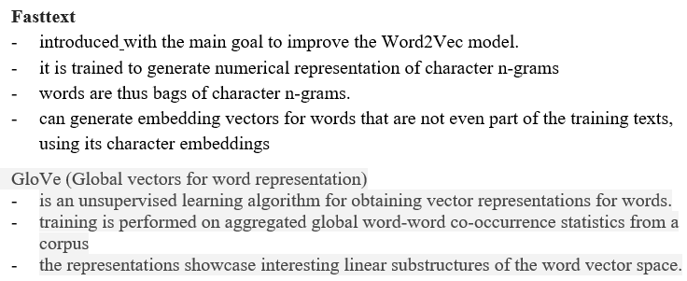
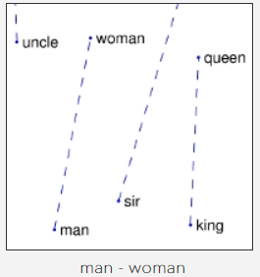
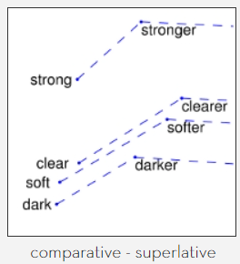

Slide 22
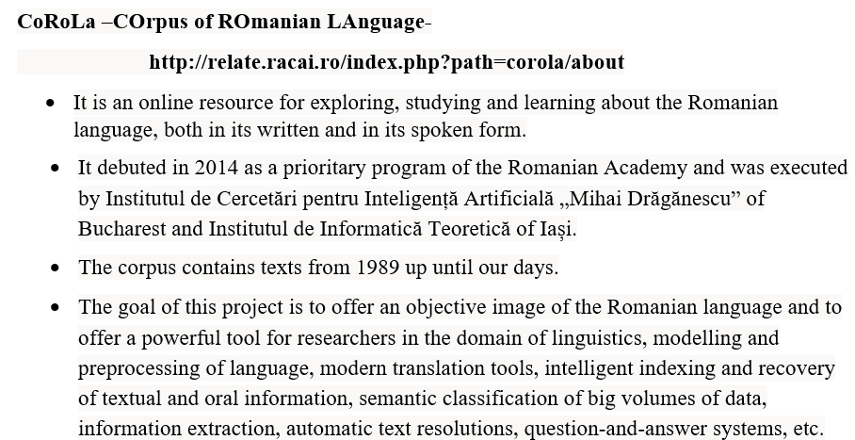

Slide 23
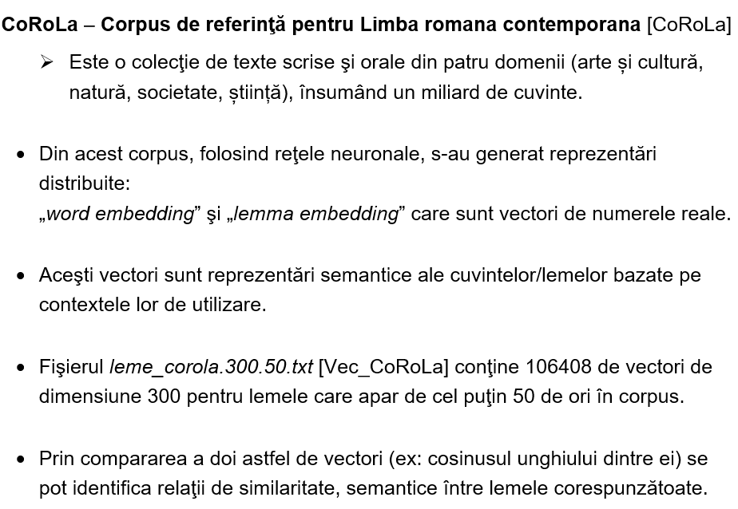

Slide 24
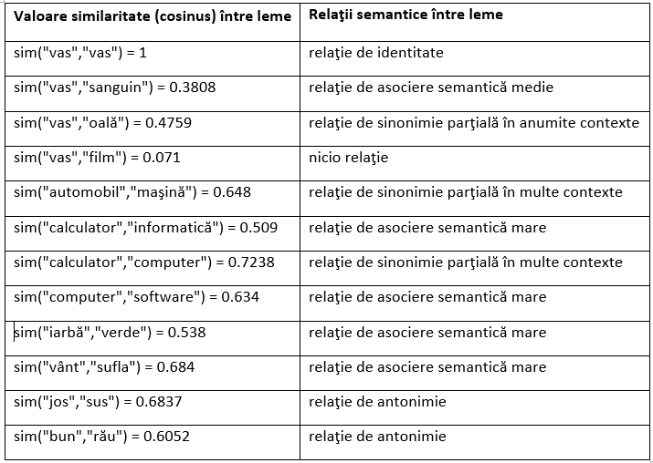
COROLA- SIMILARITATI

Slide 25
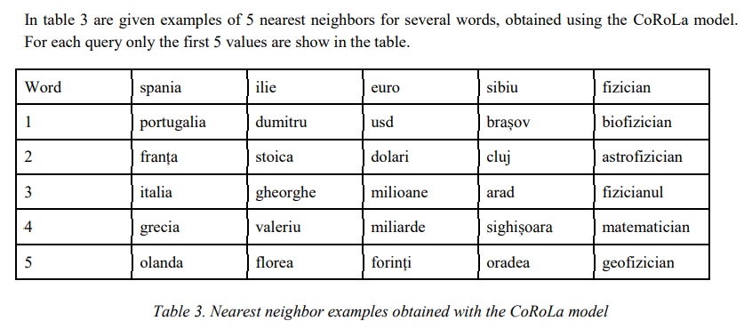
COROLA (CONT.)

Slide 26
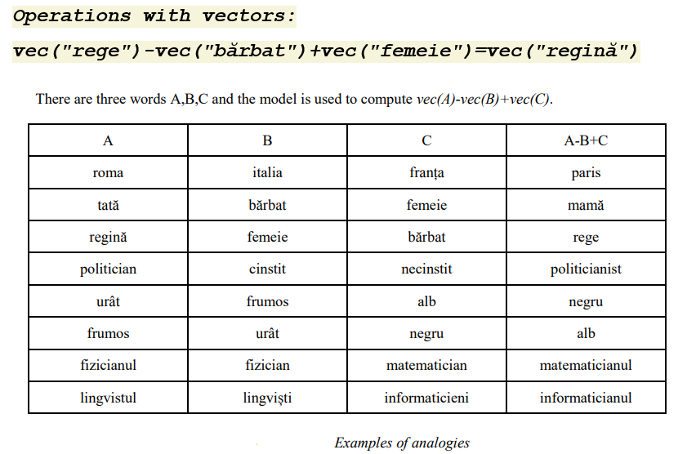
COROLA (CONT.)

Slide 27
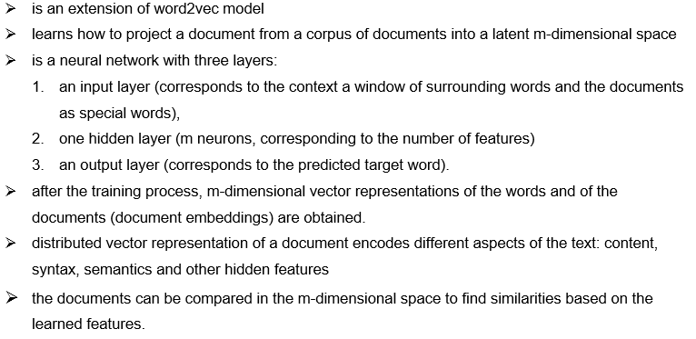
DOC2VEC (PARAGRAPH VECTOR) MODEL

Slide 28
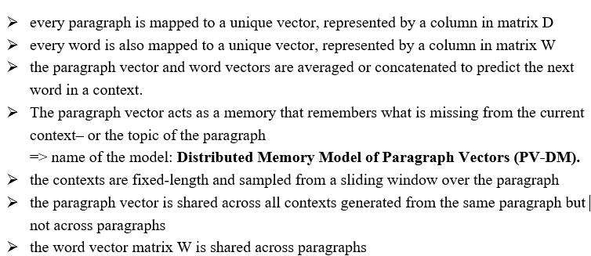
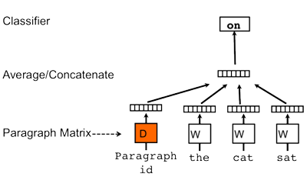
DOC2VEC

Slide 29
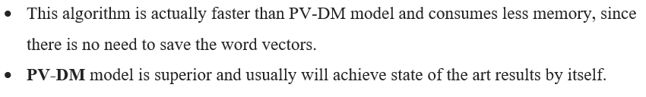
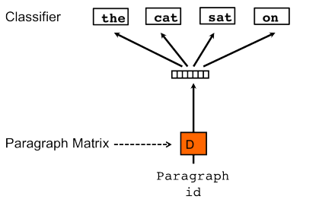
DOC2VEC: PV-DBOW MODEL

Slide 30
DOC2VEC
The doc2vec models may be used in the following way:
For training, a set of documents is required.
A word vector W is generated for each word.
A document vector D is generated for each document.
The model also trains weights for a softmax hidden layer.
In the inference stage, a new document may be presented, and all weights are fixed to calculate the document vector.

Slide 31
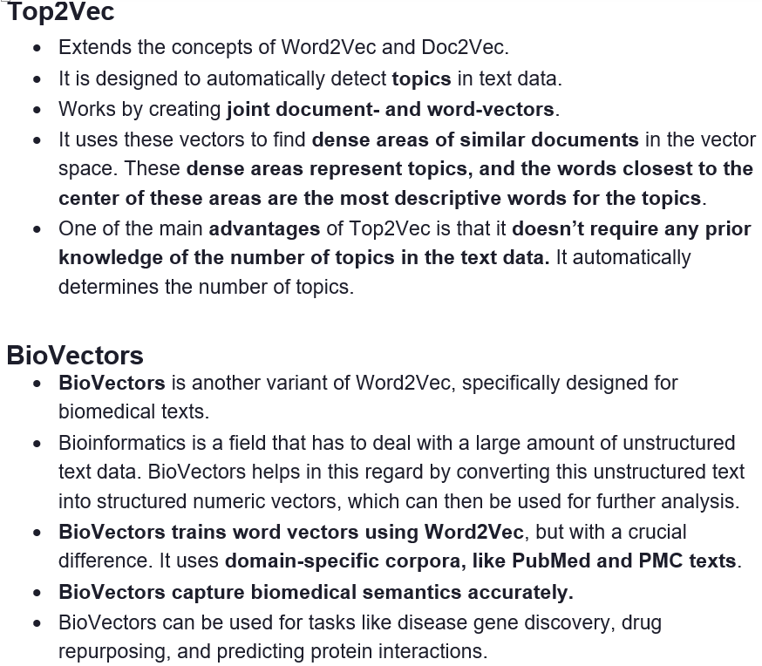

Slide 32

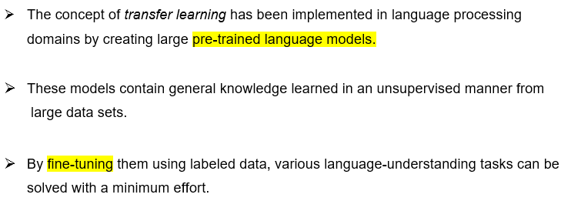

Slide 33
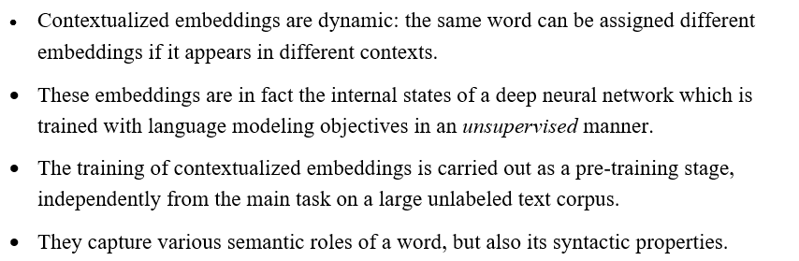
Contextualized word embeddings

Slide 34
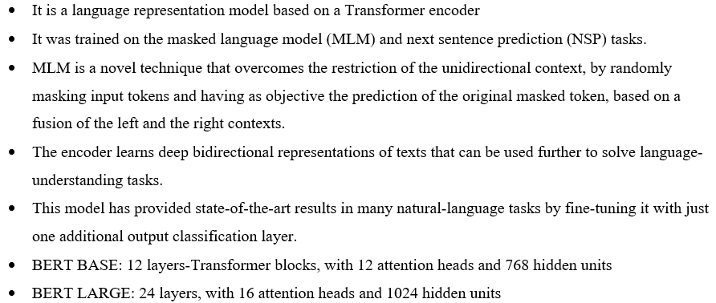
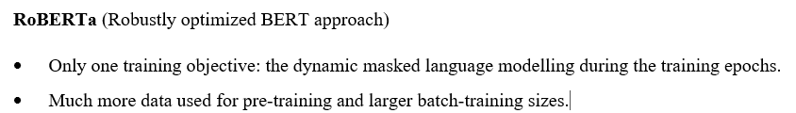
BERT (BIDIRECTIONAL ENCODER REPRESENTATIONS FROM TRANSFORMERS)

Slide 35
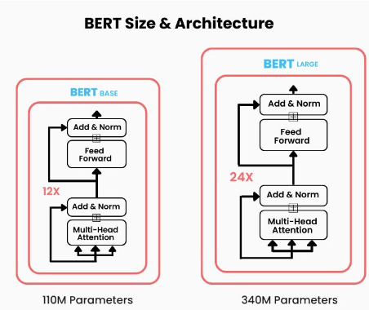

Slide 36
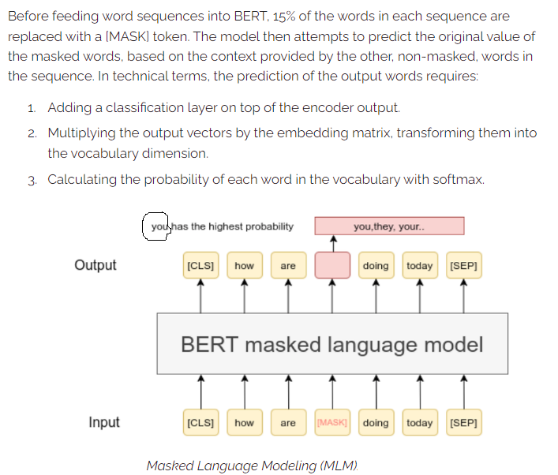
MASKED LANGUAGE MODELLING

Slide 37
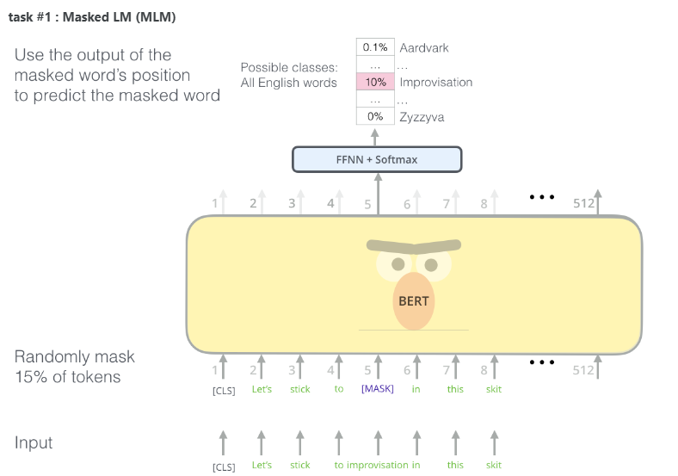

Slide 38
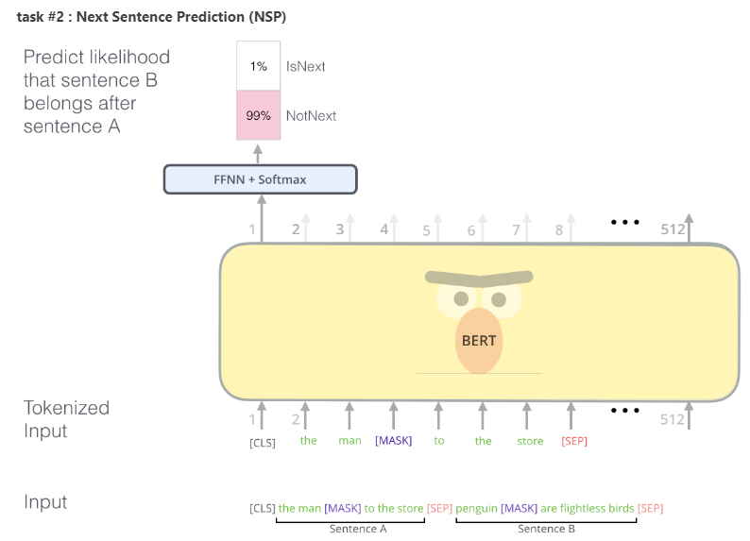

Slide 39
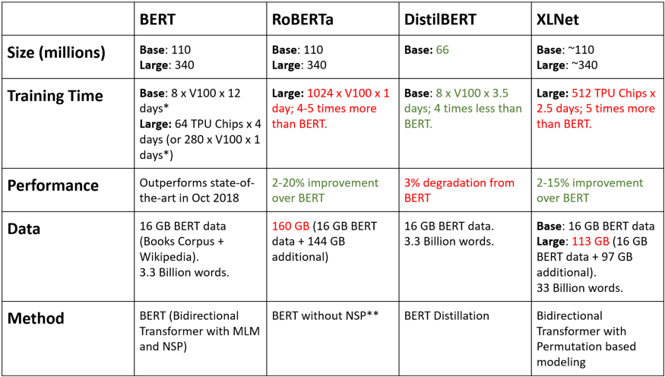
COMPARISON: BERT – ROBERTA - XLNET - DISTILBERT

Slide 40
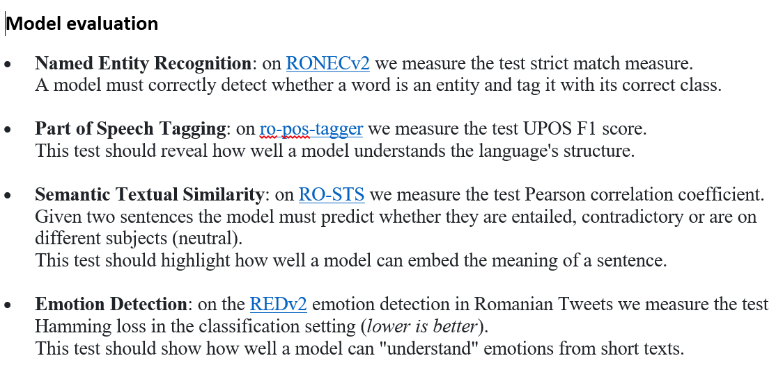
BERTS FOR ROMANIAN LANGUAGE
RoBERT
https://github.com/dumitrescustefan/Romanian-Transformers
Romanian DistilBERT: https://github.com/racai-ai/Romanian-DistilBERT

Slide 41
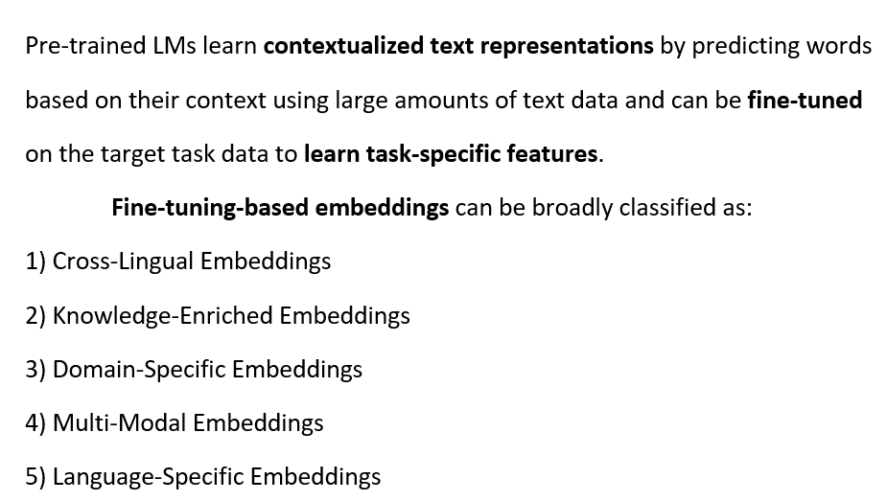
FINE-TUNING-BASED EMBEDDINGS

